Slide 1
RDBMS Project Synopsis
~ By Dhruv Chaudhary
Reg. No. : 209303197
Branch: CCE | Section: C

Slide 2
TABLE OF CONTENTS
Introduction to the project & Application Areas
Hardware and Software Requirements
Gantt chart
ER Diagram
Room for improvement

Slide 3
INTRODUCTION
Title: RETAIL MANAGEMENT SYSTEM
All Retails need some variation of a management system. A Retail management system will help with operations of a retail store. This system will be built for a single store that can be scaled up to multiple stores. A Retail management system will have multiple benefits for stores such as:
1) Provides valuable data on customers
2) Provides customer feedback
3) Increases sales
4) Better inventory management

Slide 4
HARDWARE AND SOFTWARE REQUIREMENTS
HARDWARE REQUIREMENTS:-
PC/Laptop
Processor: Intel core i7
RAM: 16GB
Graphics: Nvidia GeForce RTX 2060
SOFTWARE REQUIREMENTS:-
ORACLE Application Express (APEX)
SQL
Windows 11
OneNote

Slide 5
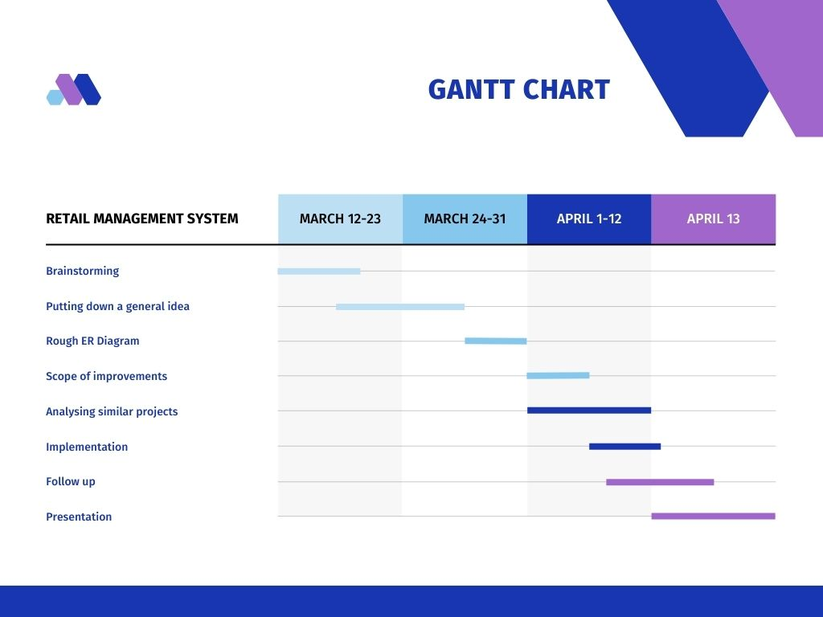


Slide 6
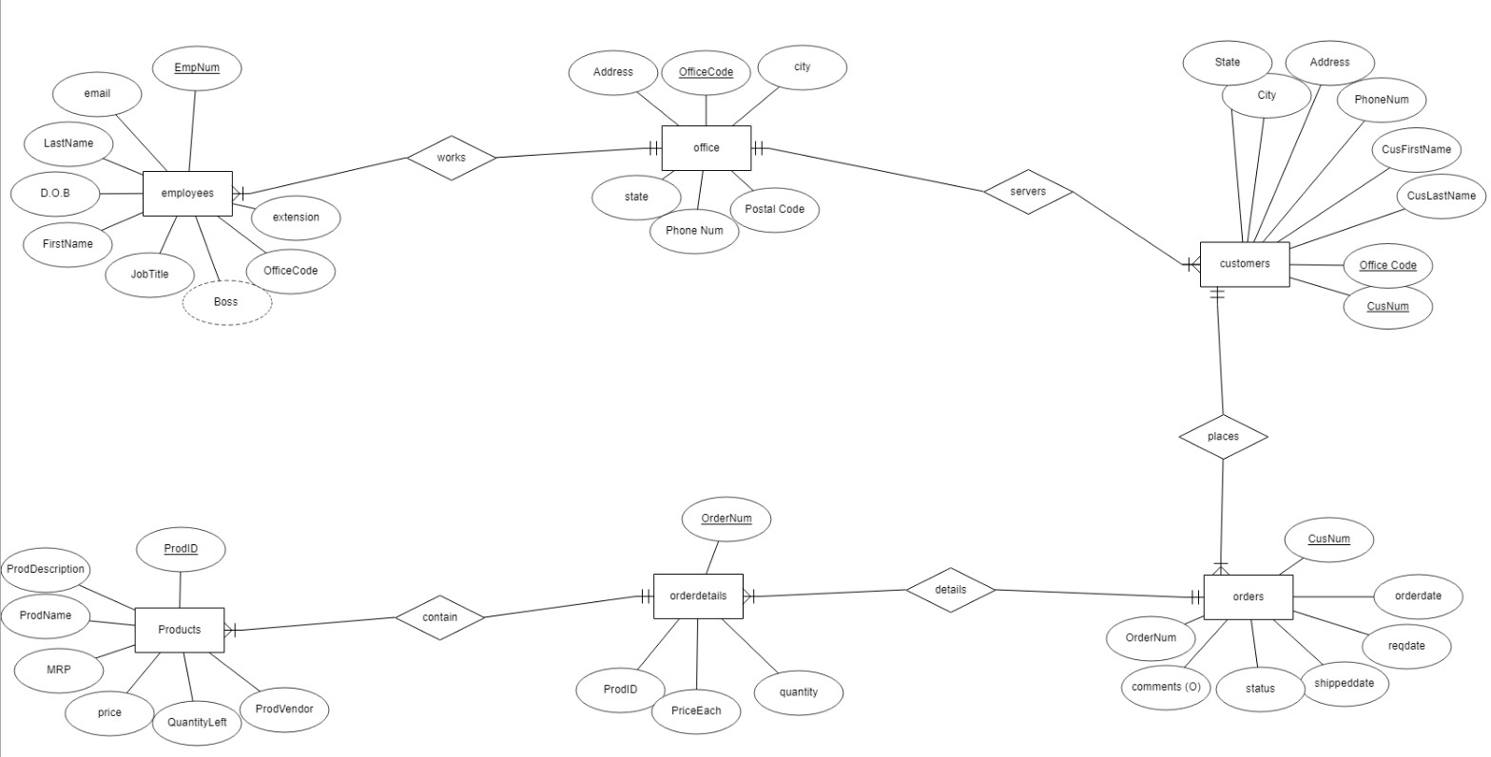
ER DIAGRAM

Slide 7
ROOM FOR IMPROVEMENT
Clarify doubts regarding Reservation through Website entity
Take up any suggestions

